Slide 1
Team 19
Reinforced Ceramic 3D Printer

Slide 2
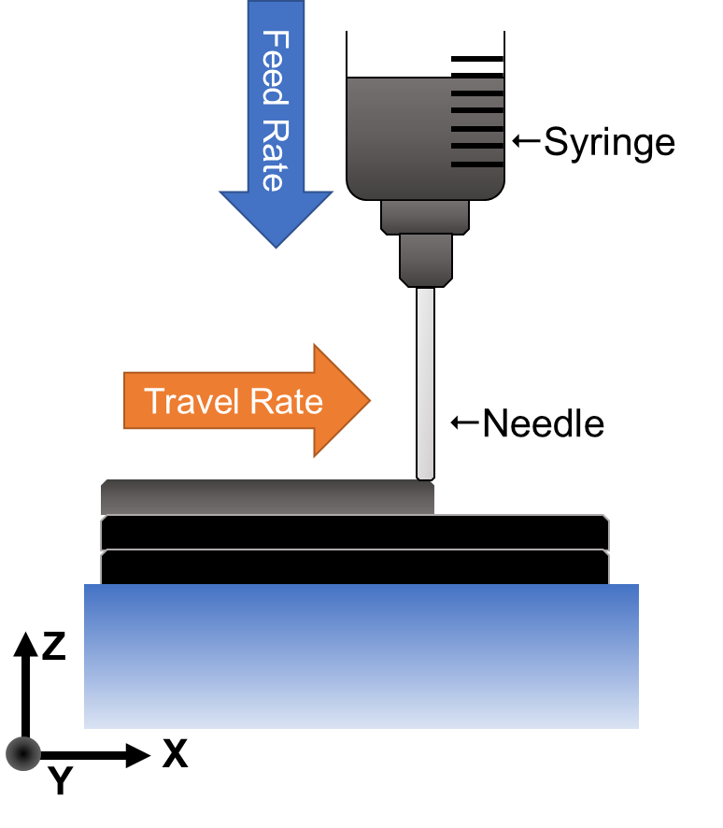
Extrusion system diagram and drawing

Slide 3
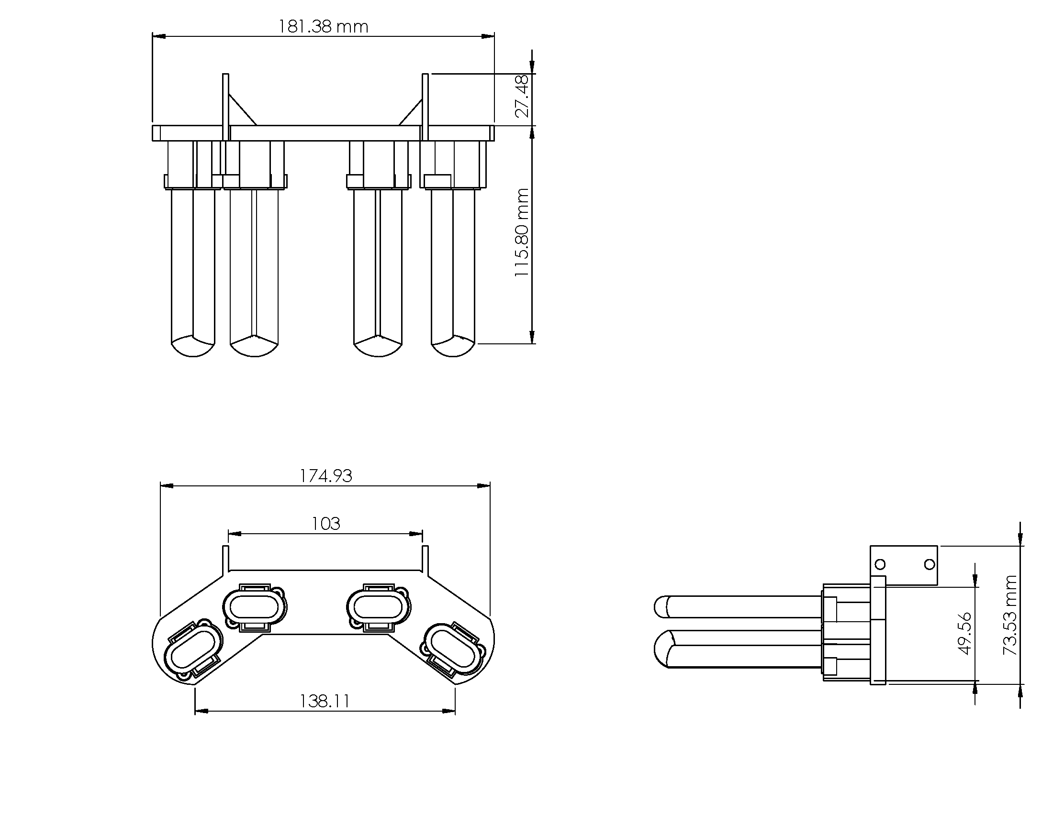
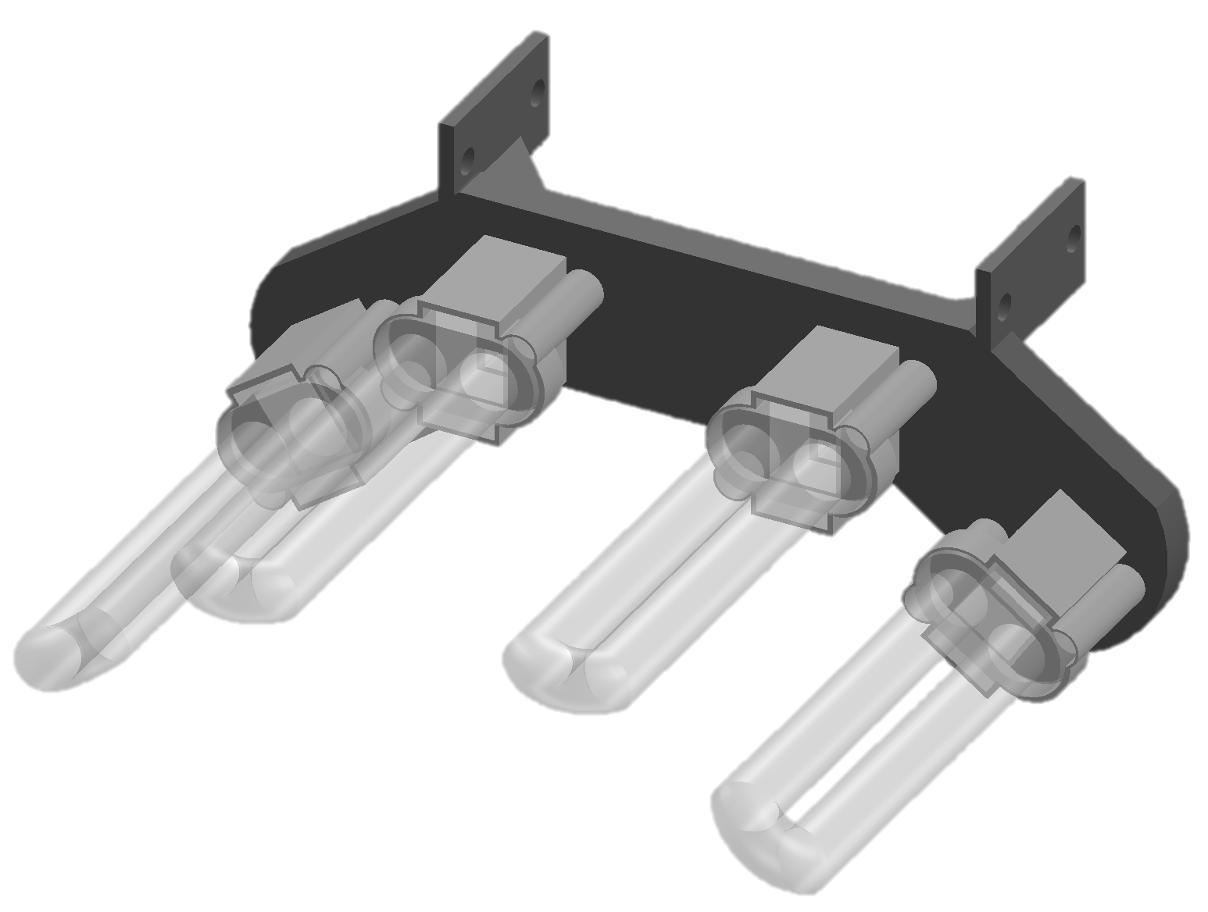
Dimensioned drawing of the curing lamp array and bracket

Slide 4
TEAM 19
Initial testing of the CNT reinforced ceramic polymer slurry extrusion using a programmable syringe pump. This was used to test viscosity variations as well as determine optimal needle gauge for the best resolution and flow rate.

Slide 5
TEAM 19
Testing the final design with both the extrusion system and curing array; each layer was printed and cured before the next layer was continued to observe the curing time required.

Slide 6
TEAM 19
Printing a gear for the syringe pump

